Slide 1
College Level Reading and Writing:
The Lens and Artifact Essay

Slide 2

Take out your Writers’ Notebook and jot down a few ideas that the image below brings to you (at least 5 items).
The artifact

Slide 3
Now, open and read your folded piece of paper. This is your “lens” and the image below is your “artifact” to examine. In your Writers’ Notebook, jot down what you notice now that your focus is specific (at least 5 items).
The artifact

Slide 4

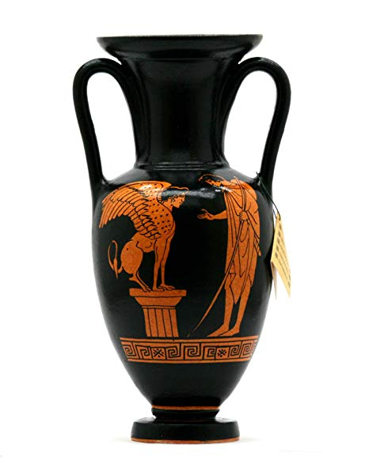
Now as a class….
Archaeologist?
Interior Decorator?
Potter?
Insurance Appraiser?
Museum Curator?
Historian?
The artifact

Slide 5
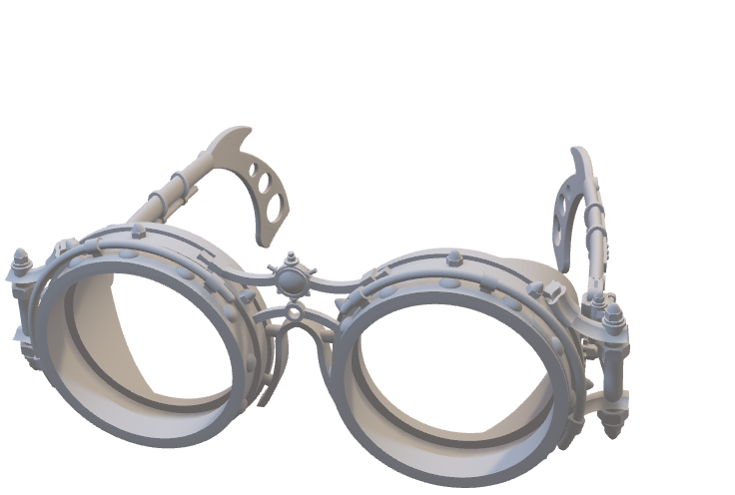
Lens and Artifact Essay:
What and Why
A lens and artifact essay is a type of comparative paper that analyzes one text through the viewpoints expressed in another.
Composing an effective lens and artifact essay is difficult even for the most seasoned of writers. However, it is an incredible intellectual exercise through which you will not only improve your writing skills but your critical reading and thinking skills as well.

Slide 6
Lens and Artifact Essay: How
You will eventually want to hone in on points of commonality and discord between the two texts, the order and manner in which you read them is crucial.
First, read the LENS TEXT to identify the author’s core arguments and vocabulary.
Next, quickly read the ARTIFACT TEXT to develop a general idea of its content.
Ask yourself:
Where do I see general points of agreement or disagreement between the two texts?

Slide 7
With these ideas in mind, go back and reread or review the artifact text carefully, through the theoretical lens, asking yourself the following questions:
What are the main components of the lens text and what are their complementary parts in the artifact text?
How can I apply the lens author’s theoretical vocabulary or logic to instances in the artifact text?
Are there instances where the lens text’s arguments don’t or can’t apply? Why is this?
It is helpful to keep a careful, written record of page numbers, quotes, and your thoughts and reactions as you read.

Slide 8
Practice makes perfect!

